Slide 1


Titolo presentazione sottotitolo
Quanser Cube 2 – Control of Rotational Inverted Pendulum (Furuta Pendulum)
Milano, XX mese 20XX
Authors : Mark Liam, Kevin Ortega, Renzo Ghiringhelli, Alfio Locatelli
Course : Automation Laboratory (5 CFU) 2023/2024

Slide 2
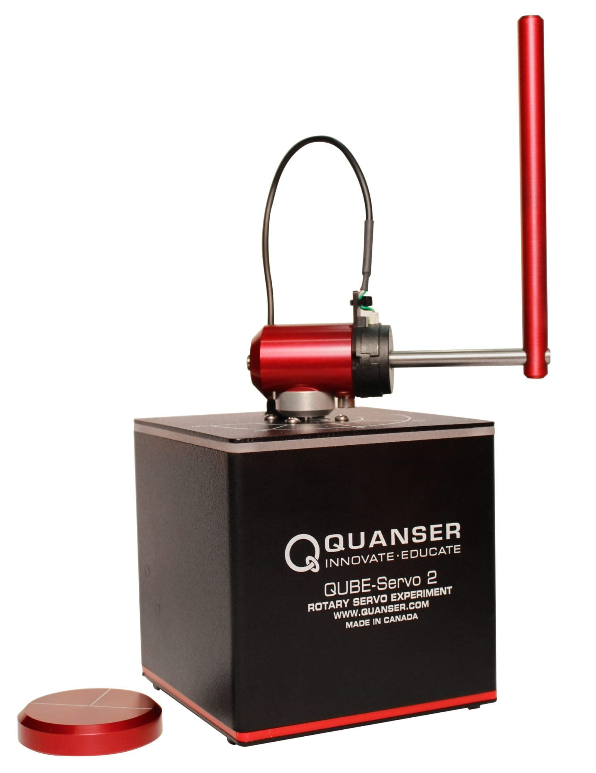
Subject Presentation

Slide 3
Goal & WorkFlow

Slide 4
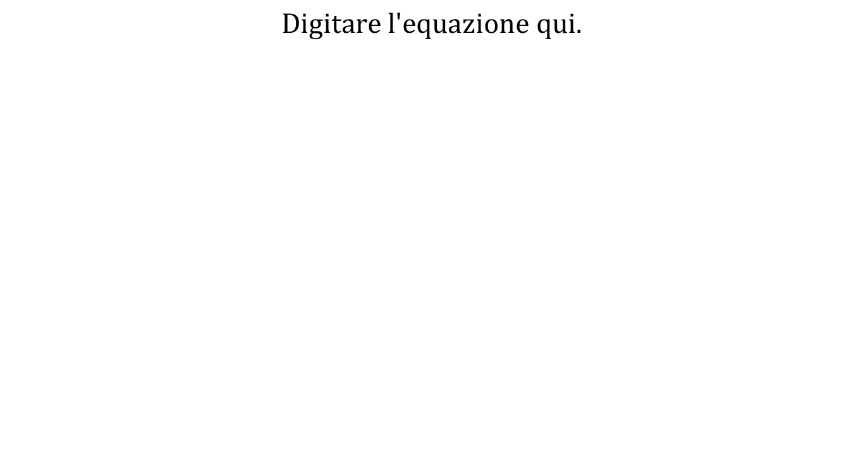
Equations of Motion

Slide 6
Parameters Estimation

Slide 11
Controllers Introduction

Slide 12
Stabilization Control

Slide 17
Swing-up Control

Slide 21
Thanks for the attention

